Slide 1



Authentication using Behavioral Biometrics
Jaypee University of Information Technology, Waknaghat - 173234 (India)
Major Project - I (18B19CI791) | AY 2024-25
End-Term Presentation
Group No.: 36
Team Member (s)
Akshit Sharma (211435)
Simran (211442)
Supervisor
Name: Dr. Kushal Kanwar
Designation: Assistant Professor (SG)
Department: CSE & IT

Slide 2
Outline
Introduction
Problem Statement
Objectives
Work Done (after Mid-Term Evaluation)
Project Design
Implementation
Experimental Results and Evaluation
Key Learnings
Work Plan for Next Semester
Work Contribution of Each Member
Supervisor Remarks
References

Slide 3
Introduction
Three key factors of authentication:
Something you know
Something you have
Something you are
Something you are : the way you behave / interact, that is, patterns in device usages
Base for our use : Sensor dynamics, touch strokes, keystroke patterns.
Our project aims to provide a seamless and non-intrusive form of second-factor authentication. It improves both usability and security. The project aims to authenticate a user, that is, know if the user is really him/herself, using their human behavioral traits, such as the way one holds their mobile phone.

Slide 4
Problem Statement
Data security by means of authentication is emerging as a very prevalent challenge in today’s world.
The need to balance usability and security is high, as by nature, we humans tend to avoid effort.
To achieve this, service providers must invest in a lot to analyze user patterns in their activity, which is not only resource heavy, but also opens a door for privacy breaches on the user side.
Our proposed solution is to use behavioral biometrics, a relatively underexplored field, in which we use behavioral data from the user, in this case, the way he/she handles his/her phone.

Slide 5
Objectives
To develop an application to gather a user’s natural behavioral information.
To develop and tailor a machine learning model to accurately identify a particular user.
To develop a prototype that implements the concept of the project.
The main objective of this project is to provide a seamless and continuous second factor of authentication to users as well as services. At this stage, we are focusing on serving the mobile applications that require this security, such as banking or online shopping services, employee portals, and even parental controls on niche applications.

Slide 6
Work Done (after Mid-Term Evaluation)
As per the plan in the mid-evaluation presentation, successfully completed the development of the data collection app : https://github.com/SimranBytes/Data-Collection-for-Behavioral-Biometrics.git
Added the following sensors:
Magnetometer (X, Y, Z)
Gyroscope (X, Y, Z)
Rotation Vector (X, Y, Z)
Tilt Detector (X, Y, Z)
Autorotation (X, Y, Z)
Motion (X, Y, Z)
The application now runs in the background and captures natural data.
Implemented a sharing feature so that the data can easily be shared.
Collected data of 25 subjects.

Slide 7
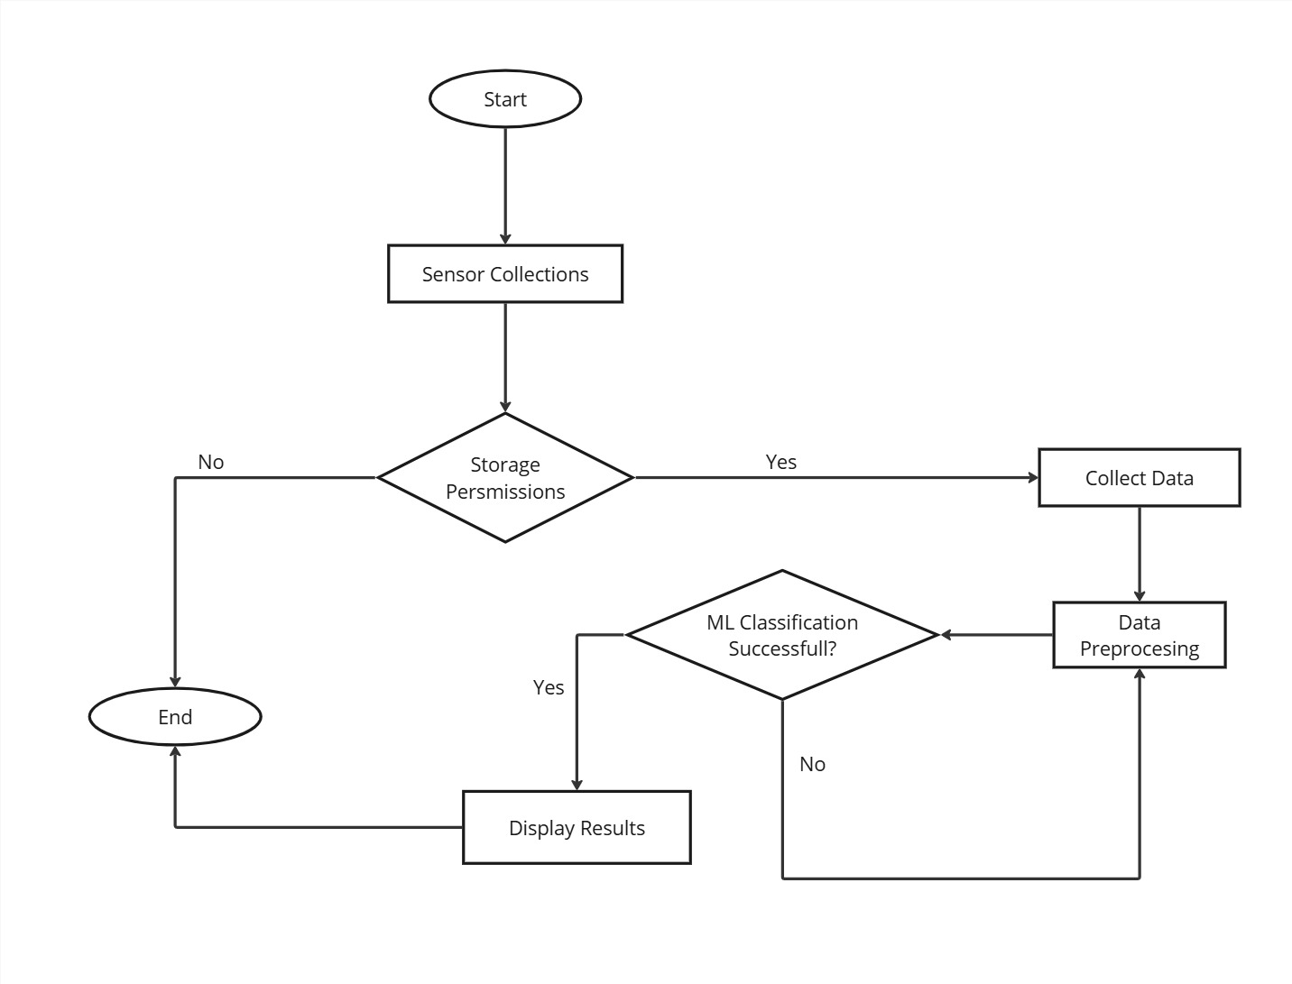
Project Design
Start: The process begins.
Sensor Collection: The system checks if the required sensors are enabled, and permissions are granted.
If No, it skips to displaying results.
If Yes, it proceeds to collect data from the sensors.
Data Collection & Preprocessing: The collected data undergoes preprocessing to make it suitable for machine learning.
ML Classification: The preprocessed data is evaluated using machine learning for classification.
If classification is successful, results are displayed.
If unsuccessful, it loops back for further processing.
End: The process ends.
Fig.1.1: Flow graph of the project

Slide 8
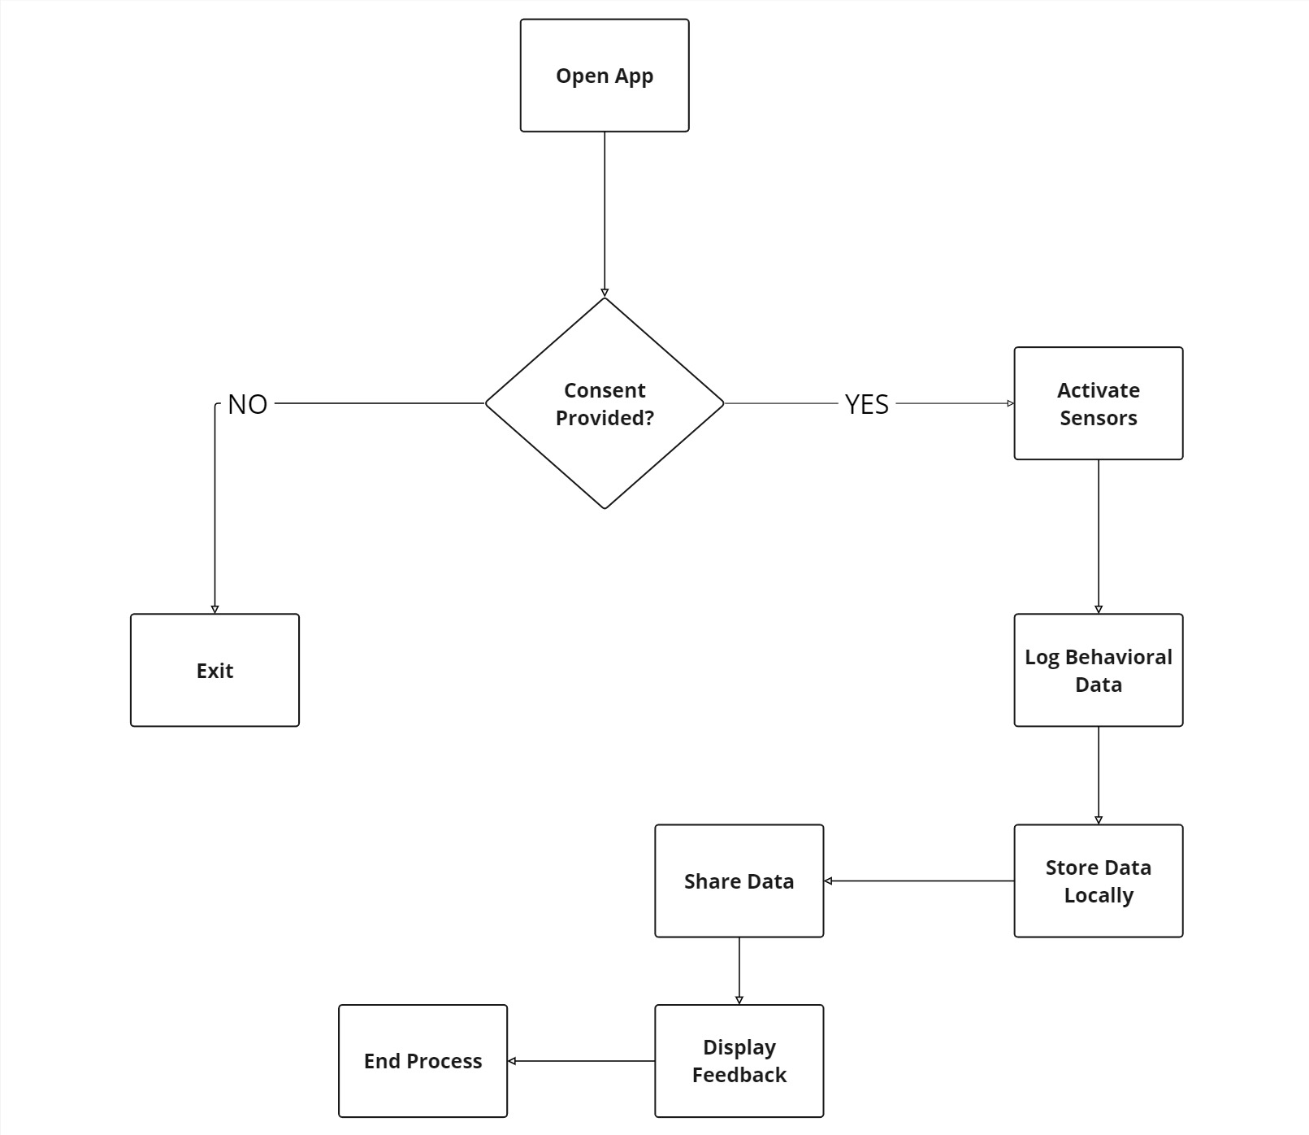
Project Design (cont…)
Open App: The process begins when the user launches the data collection application.
Consent Provided?:
If No: The app terminates the process and exits.
If Yes: The app proceeds to the next step.
Activate Sensors, Log Behavioral Data, Store Data Locally and Periodically upload to firebase
Display Feedback
End Process
Fig.1.2: Flow graph of the data collection app

Slide 9
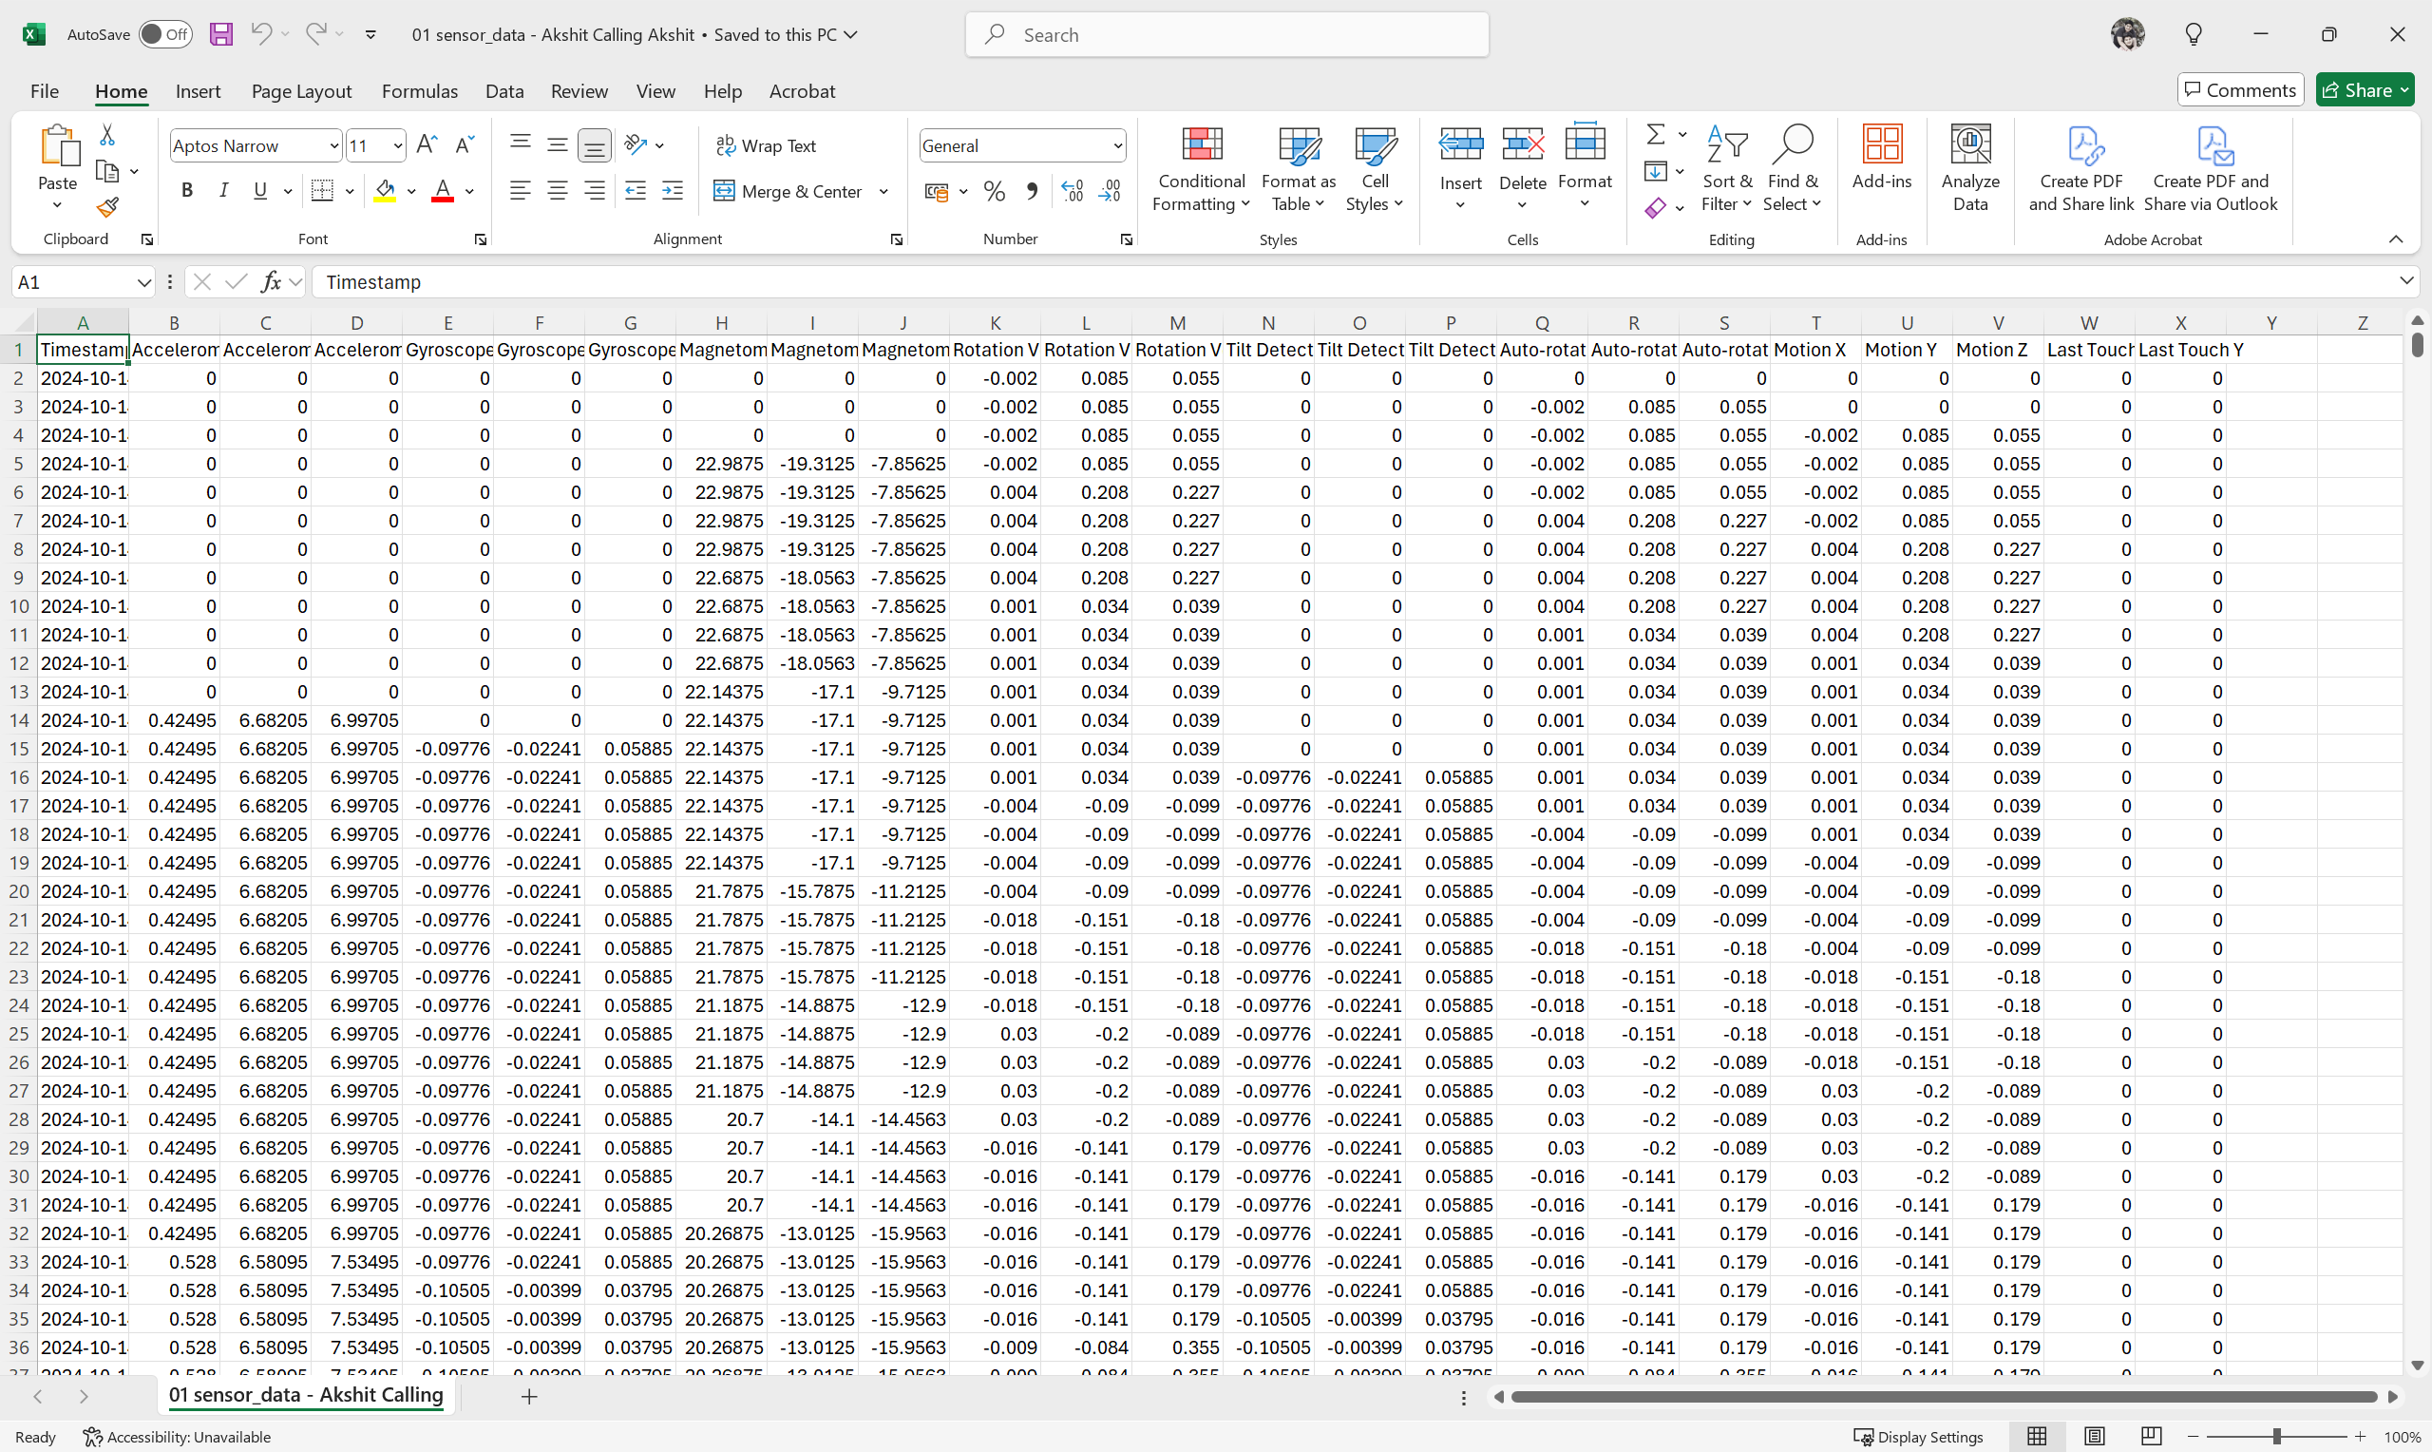
Implementation
Fig.2.1: Dataset Snippet

Slide 10
Implementation (cont…)
Total Participants | 25
Rows Collected | 55,63,802
Features | 24
Sensors Used | Accelerometer (X,Y,Z) Gyroscope (X,Y,Z) Magnetometer (X,Y,Z) Rotation Vector (X,Y,Z) Tilt Detector (X,Y,Z) Autorotation (X,Y,Z) Motion (X,Y,Z) Last Touch (X,Y)
Compatibility | Tested on Android Versions 9 to 14
Table.1: Key Metrics of the Dataset Collected

Slide 11
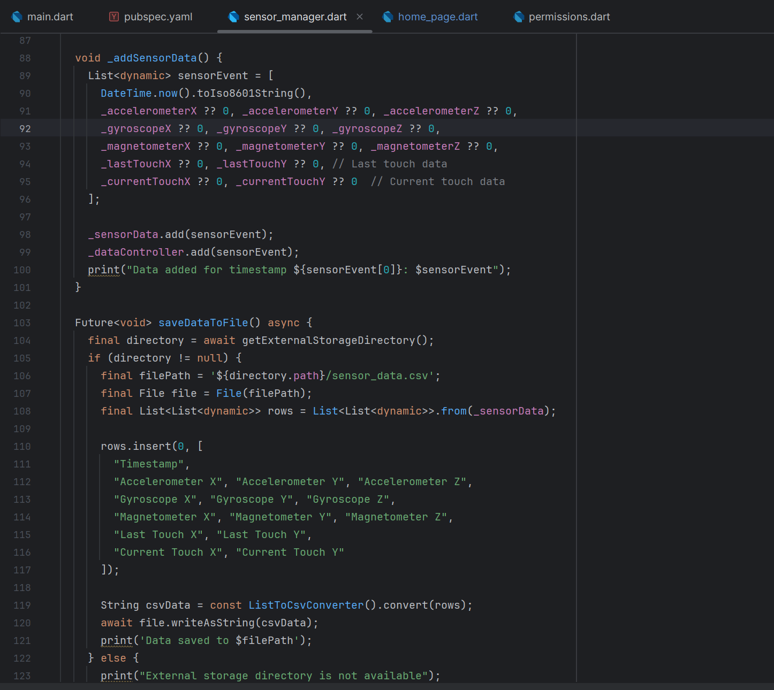
Implementation (cont…)
Fig.2.2: Data Collection Code Snippet (Dart)

Slide 12
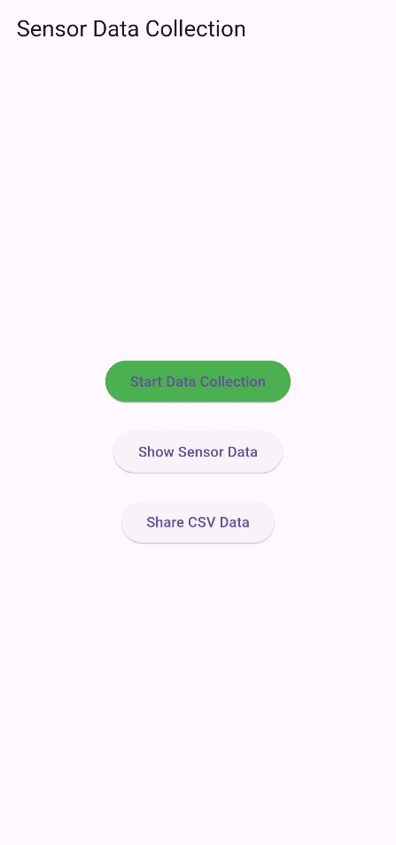
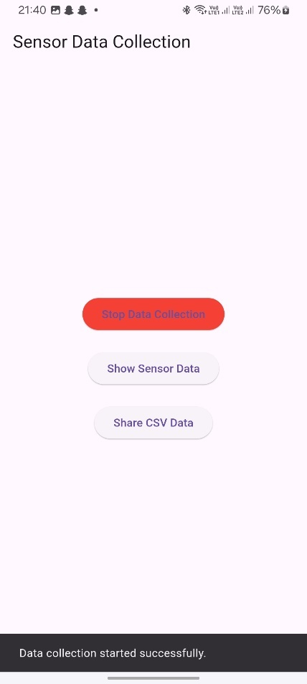
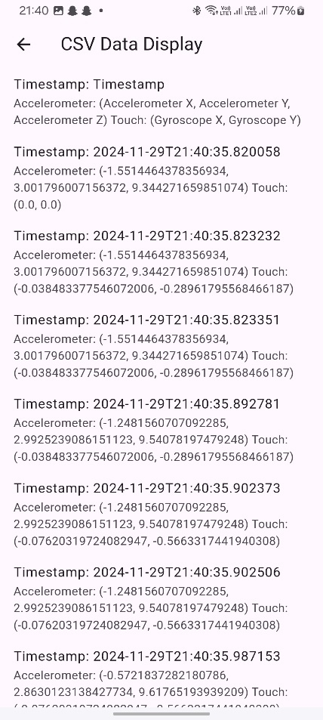
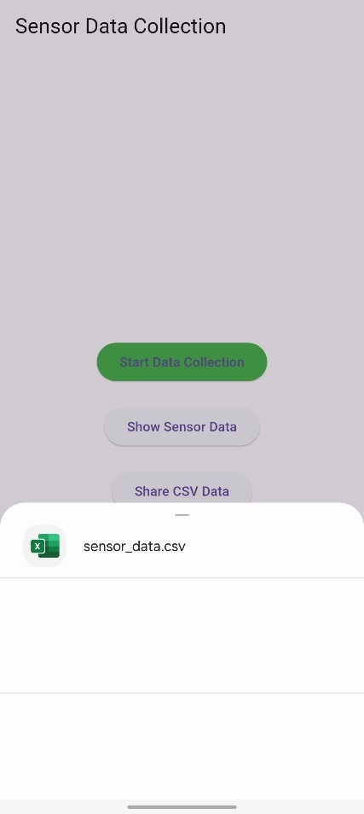
Experimental Results and Evaluation
Fig.3.1: Application Screenshots

Slide 13
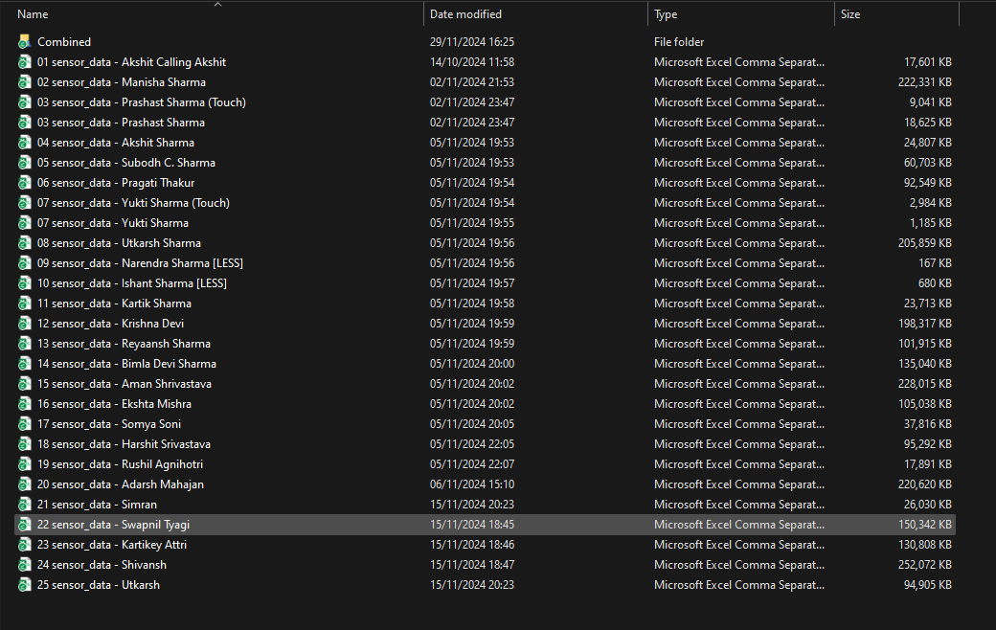
Experimental Results and Evaluation (cont…)
Fig.3.2: Collected Data(s)

Slide 14
Key Learnings
Data collection for this purpose was an extensive part of the process and hence hasn’t been explored much before.
It was important to collect data while users interacted with their devices naturally.
Natural variations need to be taken into account.
The raw data collected is very diverse. The next step should be cleaning the data for its use in a machine learning model.
Use of this app proved to be non-intrusive and users didn’t notice a difference while using their phones.

Slide 15
Work Plan for Next Semester
Next, we need to learn how to process time series data and use a basic ML model to process it.
Must learn about machine learning to tailor-make a model for this purpose.
At the same time, it is important to add the data collected and keep improving the data collection app as well.
In the next semester:
Will work on data pre-processing to begin with.
Proceed to select a machine learning model for the cleaned data.

Slide 16
Work Contribution of Each Member
S. No. | Roll No. | Work Done | Work Contribution (%)
1. | 211435 | Researched into other sensors to be integrated. Integrated more sensors into the data collection app. Collected data from participants. Documentation and write-up. | 50%
2. | 211442 | Read more research papers regarding behavioral biometrics. Bug-fixes in the data collection app, and background run. Collected data from participants. Prelimenary research into time-series data pre-processing. | 50%

Slide 17
Supervisor Remarks
S. No. | Week No. & Date (dd/mm/yy) | Remarks (as mentioned in the weekly log) | Incorporated (Yes/No)
1. | 1 (07/10/24) | OK | Yes
2. | 2 (14/10/24) | OK | Yes
3. | 3 (21/10/24) | OK | Yes
4. | 4,5,6 (11/11/24) | OK | Yes
5. | 7 (18/11/24) | OK | Yes
6. | 8 (25/11/24) | OK | Yes

Slide 18
References
[1] O. L. Finnegan, J. W. White III, and B. Armstrong, "The utility of behavioral biometrics in user authentication and demographic detection: A scoping review," Syst. Rev., vol. 13, no. 1, p. 45, 2024.
[2] L. Sun, Y. Wang, Y. Ren, and F. Xia, "Path signature-based XAI-enabled network time series classification," Sci. China Inf. Sci., vol. 67, no. 4, pp. 1–15, 2024.
[3] E. C.-Y. Su and H.-M. Wu, "Dimension reduction and visualization of multiple time series data: A symbolic data analysis approach," Comput. Stat., vol. 39, no. 2, pp. 123–140, 2024.
[4] P. Bansal and A. Ouda, "Continuous authentication in the digital age: An analysis of reinforcement learning and behavioral biometrics," Computers, vol. 13, no. 6, p. 78, 2024.
[5] P. Yris, et al., "Deep features fusion for user authentication based on human activity," IET Biometrics, vol. 12, no. 1, pp. 45-57, 2023.
[6] R. Praveen, et al., "Continuous user authentication on smartphone via behavioral biometrics: a survey," Multimedia Tools and Applications, Springer, 2023.
[7] G. Stragapede, et al., "Mobile behavioral biometrics for passive authentication," Pattern Recognition Letters, vol. 157, pp. 130-140, 2022.
[8] Z. Shihong, et al., "A Robust Continuous Authentication System Using Smartphone Sensors and Wasserstein Generative Adversarial Networks," Communication Security in Socialnet-Oriented Cyber Spaces, 2021.

Slide 19
References (cont…)
[9] B. Lavanya, et al., "Impact of Behavioral Biometrics on Mobile Banking System," Journal of Physics: Conference Series, Advances in Computational Electronics and Communication Engineering, vol. 1964, 2021.
[10] G. Jianfeng, et al., "Design and Implementation of Continuous Authentication Mechanism Based on Multimodal Fusion Mechanism," Communication Security in Socialnet-Oriented Cyber Spaces, 2021.
[11] S. Ioannis, et al., "Behavioral biometrics & continuous user authentication on mobile devices: A survey," Information Fusion, 2021.
[12] M. Abuhamad, et al., "Sensor-based continuous authentication of smartphones’ users using behavioral biometrics: A contemporary survey," IEEE Internet of Things Journal, 2021.
[13] I. Alsaadi, "Study on most popular behavioral biometrics, advantages, disadvantages and recent applications," International Journal of Scientific & Technology Research, vol. 10, no. 12, pp. 320-326, 2021.
[14] T. L. Xu, K. de Barbaro, D. H. Abney, and R. F. A. Cox, "Finding structure in time: Visualizing and analyzing behavioral time series," Front. Psychol., vol. 11, p. 2735, 2020.
[15] A. Alzubaidi and J. Kalita, "Authentication of smartphone users using behavioral biometrics," IEEE Communications Surveys & Tutorials, vol. 18, no. 3, pp. 1998-2026, 2016.
[16] A. Buriro, B. Crispo, F. Del Frari, and K. Wrona, "Touchstroke: Smartphone user authentication based on touch-typing biometrics," Springer International Publishing, 2015.

Slide 20
References (cont…)
[17] N. Zheng, K. Bai, H. Huang, and H. Wang, "You are how you touch: User verification on smartphones via tapping behaviors," IEEE, 2014.
[18] H. Saevanee and P. Bhattarakosol, "Authenticating user using keystroke dynamics and finger pressure," IEEE Proceedings of the International Conference on Computing and Convergence Technology, 2009.
[19] L. Li, X. Zhao, and G. Xue, "Unobservable re-authentication for smartphones," IEEE Transactions on Mobile Computing, vol. 12, no. 2, pp. 1-10, 2013.
[20] X. Zhao, T. Feng, and W. Shi, "Continuous mobile authentication using a novel graphic touch gesture feature," IEEE Transactions on Mobile Computing, vol. 12, no. 9, pp. 1-15, 2013.
[21] A. De Luca, A. Hang, F. Brudy, C. Lindner, and H. Hussmann, "Touch me once and I know it's you! Implicit authentication based on touch screen patterns," in Proceedings of the ACM Conference on Human-Computer Interaction with Mobile Devices and Services (MobileHCI), 2012.

Slide 21
Thanks.

